Slide 1
!
Incredible ndia
TOURIST FACILITATOR
“We need to bring learning to people instead of people to learning.” — Elliot Masie

Slide 2
IITFC - Flagship Programme
Of
Ministry of Tourism
Conceptualized, Executed, and Monitored by the Indian Institute of Tourism and Travel Management.

Slide 3
IITFC- A Futuristic Initiative
A digital initiative of the Ministry of Tourism for the citizens of India to become a part of the booming Tourism Industry.
An online platform to provide training and certification to new-age tourist facilitators.
A futuristic initiative of the Ministry of Tourism started in 2018, a year ahead of the UNWTO Online academy.
A dream project of the Honourable Prime Minister of India.

Slide 4
The Inbound and Domestic Tourist base is increasing in India.
The New Tourist wants authentic personalized service beyond monuments.
A True Tourist Friend is the need of the hour to showcase vivid colors of Indian destinations
GAP
India has only 3700 approx. (2018) Regional Level Guides.
The pan-India availability of guides is a major concern raised by the tourism industry stakeholders.
Also, for enhancing the tourist experience, a technology-based direct link between a tourist & a true friend is required.

Slide 5
IITFC Objectives
Skill Development for Indian citizens
Employment Generation for Local Communities
.
Creating a workforce of facilitators for tourism industry
Enhancing the experience of Domestic and Foreign Tourists throughout their journey in India
01
02
03
04

Slide 6
IITFC CORE AREAS
E-Courses
(LMS Based )
Assessment (online-and offline )
Communication seminar and internship
E- marketplace
ASSESSMENT
(Online & Offline)
Training
&
Internship
E-COURSES
(LMS Based)
E-Marketplace

Slide 7
E- Courses Under IITFC
Basic
Linguistic
Advance Heritage
Coming up:
Advance Art & Culture
Advance Eco-Tourism
Advance Adventure
Refresher

Slide 8
Core Focus of E- Courses
Basic
Refresher
Knowledge
Skills
Attitude
Aware
Sensitize
Unfold
Linguistic
Advance
Testing
Certifying
Upgrading
( Language Proficiency & Skills )
Upgrade
Sharpen
Deliver

Slide 9
Contains ‘Interactive Content’ in
English & Hindi
Online Learning System
Pursue online courses from ‘Anywhere and Anytime’
Can be accessed from ‘Multiple-Digital-Devices’
Self Paced Learning

Slide 10
LEARNING MANAGEMENT SYSTEM (LMS) FEATURES
Ease of Use: User friendly, Easy Navigation, Self Controlled Learning.
Content Management : Customized Programs, Learning Groups, Individual Tracking.
Multiple Platforms: Desktop / Mobile / Android / iOS / Mac compatible.
Centralized Assessments: One Platform for learning and internal assessments.
Customized Tests.
Reporting / Tracking: Live Tracking / On demand Completion Report.
Security: Secured User Data. Centralized Records.
Available to Administrator.

Slide 11
Stages of the IITFC Courses
General / Others
Payment Gateway
SC / ST
Aspiring Facilitator
Visits IITFC Programme Portal
Registration
Undergo Field Training
Trained Incredible India
Facilitator
Takes Assessment Tests
Study Online at own pace
Receives Certificate

Slide 12
Course Statistic
1
3
Basic Course
9481- Total enrolled Candidates
5859 – OCC downloaded Basic IITFC
3096* – eligible for badges
Linguist guides
French , Spanish , German ,Russian , Chinese, Korean , Japanese, Arabic ,Thai
Enrolled to date - 177
4
2
Refresher Course
( for RLG*now IITG)
*Regional Level Guides
IITTG badge holders -20
Advance (heritage)
Total Advance Enrolled Candidates -819

Slide 13
Internet Based Online Assessment Tests
(IBAT)
EXAMINATION PLAN
IITFC Basic Examination IBAT will be conducted in two parts :
First day – General Module & one mandatory State Specialisation –Morning
-- One Extra Specialisation – Evening
Second day- Additional State Specialisation as per Candidates choice
Exam will be Bilingual – English & Hindi

Slide 14
Training – Communication Seminar
Eligibility
Mode
Candidates who successfully qualify Basic IITFC Online Assessment
Conducted Online using standardized content
Focus
Duration
Focused on enhancing communication skills and right facilitation attitude
Seven days intense training
It will also incorporate practical insights on the content read by aspirants.
Evaluative exercises and role play will be an integral part of communication seminar.

Slide 15
World is moving ahead
Inconsistence customer experience
Bad customer experience
No checks and balances in place
Lack of digital platform
Industry challenges

Slide 16
Launch Objectives
Creation of employment through make in India.
Help to deliver a next generation e-Marketplace for online collaboration
Help deliver a personalised and consistent customer experience
Empower MOT to have better control over tourism in India

Slide 17
Platform Highlights
Tour Guides Real-Time Search
Real time Destinations search
Advance search with popular filters based on Gender, Destination, Language etc.
Refined Listing of IITF & IITG’s
Quick & detailed view for Guides Profile
Guides & User Dashboards
Bi-lingual platform in Hindi & English

Slide 18
Solution Overview
MOT / IITTM Accreditation
IITFC Refresher Completion
eMarketplace
PROSPECTIVE
TOURISTS
INCREDIBLE INDIA TOURIST GUIDES
PROSPECTIVE
TOURIST FACILITATORS
Learning Management System
Evaluation &
Certification
Self Service
Onboarding
Service & Product Configuration
Moderation
SEARCH Function
Messaging and Enquiries
Service booking & Scheduling
Payments & Refunds
Both side mutual Ratings
Dispute Resolution
Referrals & Promotion
Integrate with Incredible India
Register
e Courseware
e Training
Campus Training
Online & Offline
Certification
Grading
Single Sign-On eMarketplace ECOSYSTEM

Slide 19
Current Benefits
A unique Online IITF Certification Program with great outreach
An Online Learning Management System - LMS
An Online Evaluation & Certification portal
A robust Institution IITTM enriching & improving the Program
Govt. of India Mentoring the Revolutionary idea, under Incredible India initiative

Slide 20
Future Actions
Destination Database expansion covering small cities, villages and even the uncovered destinations of India.
Real time Booking of Guides & facilitators via e-Marketplace platform.
Feedback system integration within platform for two-way ratings sharing.
Launch of Mobile Apps to ease users, guides & facilitators to have an easy access to platform anytime and possibly anywhere.
Marketing Strategy & Promotion & SEO on & off platform.

Slide 21
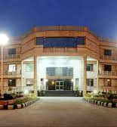
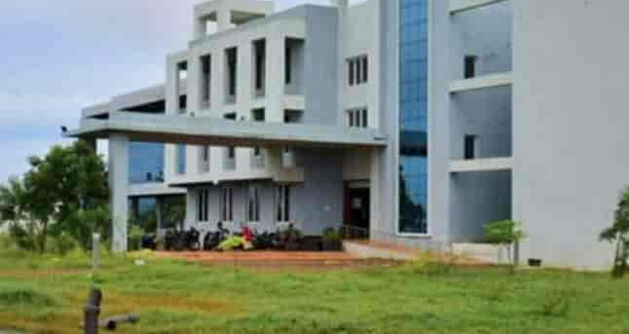
Thank You
INDIAN INSTITUTE OF TOURISM AND TRAVEL MANAGEMENT

Slide 22
Road to Success
Basic IITFC Certification
Stepping stone to unlock other courses
Atulya Bharat Badge
Empowered workforce, ready to offer superior tourist experience.

